Slide 1

Game Theory I
HE3001, Microeconomics 3 Nanyang Technological University

Slide 2
Introduction
In Micro 1 & 2, we have mostly focused on perfectly competitive scenarios.
E.g. Consumers, producers are price takers and do not consider how their choices affect other’s choices: no strategic thinking!
But in many real-life scenarios, with fewer interacting agents, strategic thinking is important!
Need to consider how one’s actions will affect other’s actions.
These strategic concerns often have impacts on social efficiency.
Game theory helps to model such strategic behavior

Slide 3
Game Theory Applications
In the next three lectures, we will cover some basics of game theory.
Where can game theory be applied?
Firms: Oil companies, Carmakers, Amazon, Google, Insurance …
Government: Market regulation, Competition Policies, Auctions…
Organisations: Human resources, Managerial policy, …
Socio-Biology: Evolution of traits, behaviour, culture…
Day to Day Life: Football, PC gaming, Relationships…

Slide 4

A simple example..
To see how games are generally formulated, let us consider the game: rock-paper-scissors.
2 players participate in this game.
Each of them can choose between three options: i) rock, ii) paper or iii) scissors.
Players have to make their choice at the same time.
No information what the other player is going to choose.
Rock defeats scissors, Paper defeats Rock, Scissors defeats paper, while the rest are draws.
Set of players
Set of actions
Strategy
Order of moves
Information
Payoffs

Slide 5
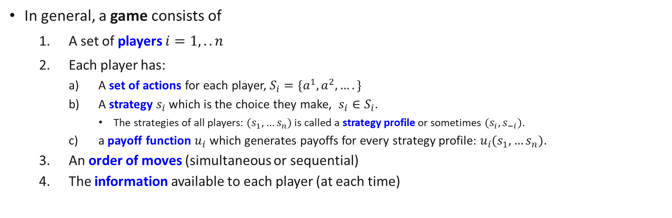
Parameters of a Game
In general, a game consists of
A set of players $i=1,..n$
Each player has:
A set of actions for each player, $S_{i}=\{a^{1},a^{2},….\}$
A strategy $s_{i}$ which is the choice they make, $s_{i}∈S_{i}$.
The strategies of all players: $(s_{1},…s_{n})$ is called a strategy profile or sometimes $(s_{i},s_{−i})$.
a payoff function $u_{i}$ which generates payoffs for every strategy profile: $u_{i}(s_{1},…s_{n})$.
An order of moves (simultaneous or sequential)
The information available to each player (at each time)
Complete or Incomplete information about other player’s types (Payoff functions, Action sets);
Perfect or Imperfect information about what other players have done.
More on this later!
Notes:
In game theory, an important part of it is to be able to identify what kind of game it is. These are usually determined by items 3 and 4. Only after identifying what kind of game it is, will you be able to apply the proper concepts to solve it.

Slide 6
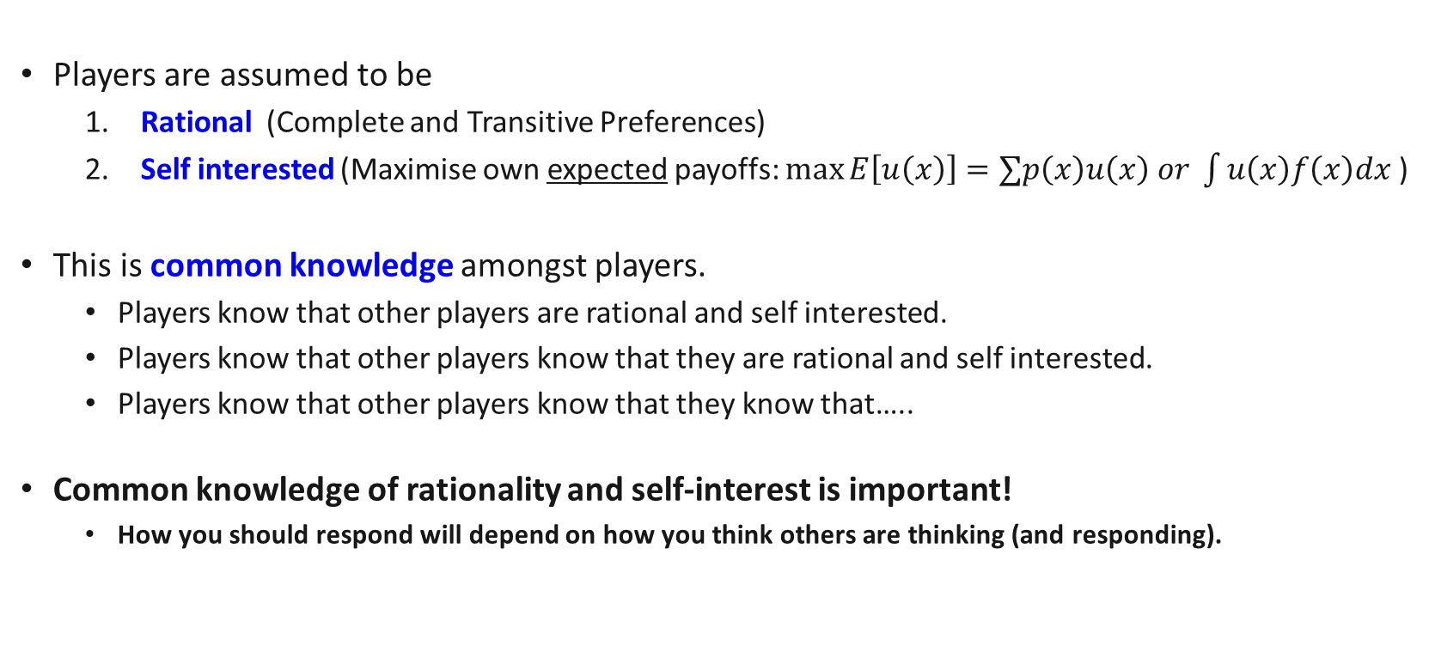
Assumptions about Players
Players are assumed to be
Rational (Complete and Transitive Preferences)
Self interested (Maximise own expected payoffs: $\max{E\left[u\left(x\right)\right]=∑p\left(x\right)u\left(x\right) or \int{u\left(x\right)f\left(x\right)dx}}$ )
This is common knowledge amongst players.
Players know that other players are rational and self interested.
Players know that other players know that they are rational and self interested.
Players know that other players know that they know that…..
Common knowledge of rationality and self-interest is important!
How you should respond will depend on how you think others are thinking (and responding).

Slide 7
Static Games of Complete Information
In this lecture, we will focus on the simplest case of static games of complete information.
In these kinds of games,
Static: Players choose their strategies simultaneously at only one point in time.
Complete information: Players know exactly the set of actions everyone can choose and the consequent payoffs.
Imperfect information: Because of simultaneity, players do not know what others have chosen.
For simplicity, we will mostly be considering games where there are only two players.

Slide 8
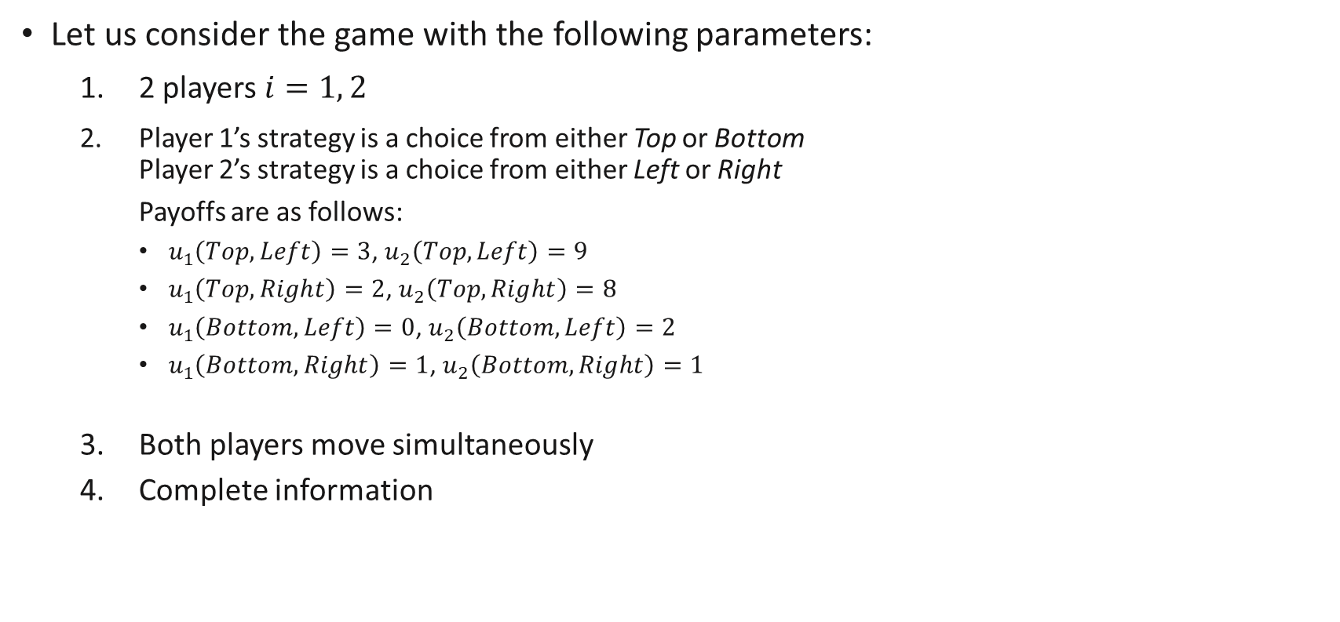
Two-Player (Static) Games
Let us consider the game with the following parameters:
2 players $i=1, 2$
Player 1’s strategy is a choice from either Top or Bottom Player 2’s strategy is a choice from either Left or Right
Payoffs are as follows:
$u_{1}\left(Top,Left\right)=3$, $u_{2}\left(Top,Left\right)=9$
$u_{1}\left(Top,Right\right)=2$, $u_{2}\left(Top,Right\right)=8$
$u_{1}\left(Bottom,Left\right)=0$, $u_{2}\left(Bottom,Left\right)=2$
$u_{1}\left(Bottom,Right\right)=1$, $u_{2}\left(Bottom,Right\right)=1$
Both players move simultaneously
Complete information
Each of these 4 are strategy profiles

Slide 9
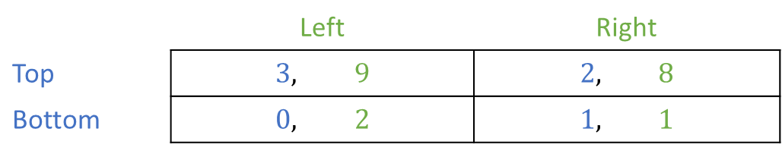
Two-Player (Static) Games
Such games can be represented easily using payoff matrices or normal form.
Complete information means that both players know about this full payoff matrix.
Player 2
 | Left | Right
Top | $$3, 9$$ | $$2, 8$$
Bottom | $$0, 2$$ | $$1, 1$$
Player 1

Slide 10

Review Questions 1
Player B
 | L | R
A
B
C
Player A
What is Player A’s set of actions? A, B, C
If both players move simultaneously, which of the following best describes information here.
Perfect Information, Imperfect Information, Complete Information, Incomplete Information. Correct Answers: Imperfect and Complete information
How many strategy profiles are there? 3*2 = 6

Slide 11
Analysing Outcomes (Dominant and Dominated Strategies)

Slide 12
Dominated Strategies
One simple way to predict the kind of outcomes for a game is to look at what strategies will (not) be used.
A strategy is dominated when it is always worse than another (fixed) strategy.
Intuitively, a dominated strategy is a very bad strategy because there is always a fixed alternative that does better.
A dominant strategy is one which is always better than other strategies.
Intuitively, they are very good strategies that should always be chosen.
In other words, other strategies besides the dominant strategy should not be chosen

Slide 13

Dominated Strategies
A strategy can be weakly or strictly dominated:
A strategy $s_{i}$ is strictly dominated by another strategy $s_{i}′$ if it always gives a strictly lower payoff than $s_{i}′$ no matter what strategies $s_{−i}$ other players choose.
$s_{i}^{′}≻^{S}s_{i}$ if $u_{i}\left(s_{i},s_{−i}\right)<u_{i}(s_{i}^{′},s_{−i})$ for any $s_{−i}$
A strategy $s_{i}$ is weakly dominated by another strategy $s_{i}′$ if it always gives a weakly lower payoff than $s_{i}′$ no matter what strategies $s_{−i}$ other players choose and a strictly lower payoff for some set of strategies of other players $s_{−i}′$.
$s_{i}^{′}≻^{W}s_{i}$ if $u_{i}\left(s_{i},s_{−i}\right)≤u_{i}(s_{i}^{′},s_{−i})$ for any $s_{−i}$
and $u_{i}\left(s_{i},s_{−i}^{′}\right)<u_{i}\left(s_{i}^{′},s_{−i}^{′}\right) \text{for} \text{some} s_{−i}^{′}$

Slide 14

Dominant Strategies
A strategy can be weakly or strictly dominant:
$s_{i}$ is a strictly dominant strategy for player $i$ if all other strategies $s_{i}′$ are strictly dominated by it.
$s_{i}≻^{S}s_{i}^{′}$ for any $s_{i}′$
$s_{i}$ is a weakly dominant strategy for player $i$ if all other strategies $s_{i}′$ are weakly dominated by it.
$s_{i}≻^{W}s_{i}^{′}$ for any $s_{i}′$

Slide 15
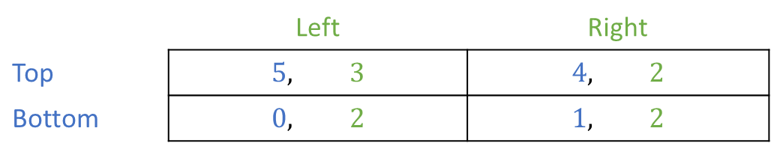
Dominated Strategies (example)
In this example,
Bottom is strictly dominated by Top for Player 1.
Right is weakly dominated by Left for Player 2.
Player 2
 | Left | Right
Top | $$5, 3$$ | $$4, 2$$
Bottom | $$0, 2$$ | $$1, 2$$
Player 1

Slide 16

Dominant Strategies (example)
In this example,
T is a strictly dominant strategy for player 1 as all other strategies (B) are strictly dominated by T.
L is a weakly dominant strategy for player 2 as all other strategies (R) are weakly dominated by L. (When player 1 chooses bottom, player 2 is indifferent between L and R)
Player 2
 | Left | Right
Top | $$3, 9$$ | $$2, 8$$
Bottom | $$0, 2$$ | $$1, 2$$
Player 1

Slide 17
Dominated vs Dominant strategies
Dominated strategies are not exactly the “opposite” of a dominant strategy!
A dominant strategy dominates all other strategies.
A dominated strategy is dominated by another strategy which may or may not be a dominant strategy.
An exception is when the set of actions only has 2 choices: if a strategy is dominated, the other strategy must be a dominant strategy and vice versa.
This can be observed in the previous example.

Slide 18
Dominated vs Dominant strategies (example)
Both players here do not have any dominant strategy, but both have dominated strategies.
Player 2
 | Left | Center | Right
Top | 20,10 | 10,20 | 100,0
Middle | 30,0 | 25,10 | 50,0
Bottom | 0,100 | 0,200 | 0,500
Player 1
Notes:
Left is dominated by Center. Center is not dominant as Right is sometimes better.
Bottom is dominated by Top or Middle. Top or Middle can be better depending on what Player B does.

Slide 19
Dominance solvable games
One way to solve for likely outcomes is to eliminate dominated strategies iteratively.
(Randomly) Pick one of the players, eliminate a single bad strategy of the player (if any)
Repeat Step 1 until none of the players have any bad strategies to be eliminated.
Intuition: Since a dominated strategy is a bad strategy, the player will not use it. Because of common knowledge, all other players know that the player will not use it as well. Then, it is as if we can eliminate this strategy from consideration.
Consequently, consider a new game where the dominated strategy is not present. The above reasoning follows until there are no more dominated strategies.

Slide 20
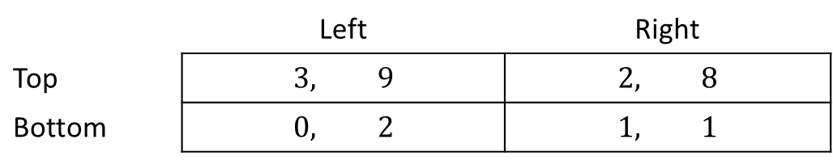
Dominance solvable games (example)
Example 1:
Player B
 | Left | Right
Top | $$3, 9$$ | $$2, 8$$
Bottom | $$0, 2$$ | $$1, 1$$
Player A
Right is strictly dominated by Left for Player B.
Given the remaining entries, Bottom is strictly dominated by Top for Player A. (The order can be reversed here.)

Slide 21
Dominance solvable games (example)
Example 2:
Player B
 | Left | Center | Right
Top | 20,10 | 10,20 | 100,0
Middle | 30,0 | 25,10 | 50,0
Bottom | 0,100 | 0,200 | 0,500
Player A
Bottom is strictly dominated by Middle or Top for Player A.
Given the remaining entries, Left and Right are strictly dominated by Center for Player B.
Given the final set of remaining entries, Top is strictly dominated by Middle for Player A.

Slide 22
Dominance solvable games (alternatively..)
Example 2:
Player B
 | Left | Center | Right
Top | 20,10 | 10,20 | 100,0
Middle | 30,0 | 25,10 | 50,0
Bottom | 0,100 | 0,200 | 0,500
Player A
Bottom is strictly dominated by Middle or Top for Player A.
Given the remaining entries, Right is strictly dominated by Center for Player B.
Given the remaining entries, Top is strictly dominated by Middle for Player A.
Given the final set of remaining entries, Left is strictly dominated by Center for Player B.

Slide 23
Dominance solvable games
We can do this procedure, eliminating iteratively either only
Strictly dominated strategies OR
Weakly dominated strategies
Note: since we are picking a player randomly, the order of eliminations might be different.
When eliminating strictly dominated strategies, this does not matter
When eliminating weakly dominated strategies, this will matter
The tutorial will cover some examples of this!

Slide 24
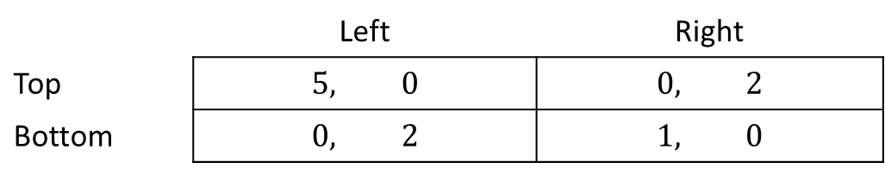
Dominance solvable
We say that a game is (weakly) dominance solvable if iteratively eliminating (weakly) strictly dominated strategies leads to one remaining entry in the matrix for some order of eliminations.
If a game is dominance solvable, the single remaining entry is a likely outcome.
However, such solutions do not always exist!
In the example below, no strategies can be eliminated…
Player B
 | Left | Right
Top | $$5, 0$$ | $$0, 2$$
Bottom | $$0, 2$$ | $$1, 0$$
Player A

Slide 25
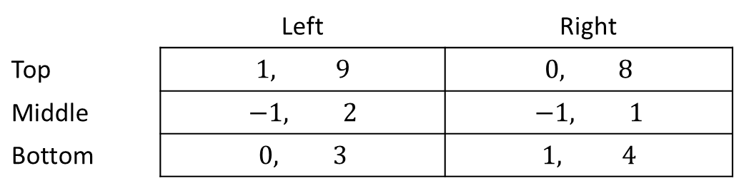
Review Questions 2
Player B
 | Left | Right
Top | $$1, 9$$ | $$0, 8$$
Middle | $$−1, 2$$ | $$−1, 1$$
Bottom | $$0, 3$$ | $$1, 4$$
Player A
Does Player A have i) a dominant strategy - No, ii) a dominated strategy? Yes – middle dominated by top or bottom
Does Player B have i) a dominant strategy - No , ii) a dominated strategy? - No
Is the game dominance solvable? No

Slide 26
Analysing Outcomes (Nash Equilibria)

Slide 27
A different solution concept..
Earlier, we learned to make predictions via dominance solvability.
However, a lot of games are not dominance solvable: there are not always very bad or very good strategies.
Other solution concepts: rationalizability, minmax strategies, maxmin strategies.
All of them suffer from the same problem: a lot of games do not have a solution based on these concepts.
We now introduce a different solution concept: the Nash equilibrium.
It is by far, the most popular and well accepted solution because it exists almost all the time.
But in some situations, it can give poor predictions..

Slide 28
Nash Equilibria (NE)
What could be other reasonable outcomes?
If in a strategy profile, Player 1’s strategy is the best response to Player 2’s strategy and vice versa, this is likely to be “stable”.
No one will want to deviate from their strategy and this is what we call a Nash equilibrium.
Interpretation: In the Nash equilibrium, each player correctly anticipates what the other will do (rational expectations) and chooses their best strategy in response. They are able to correctly anticipate what others will do because of common knowledge of rationality: if I choose my best strategy, I know the other will also choose his best strategy.
Notes:
Remember we have imperfect information here.

Slide 29
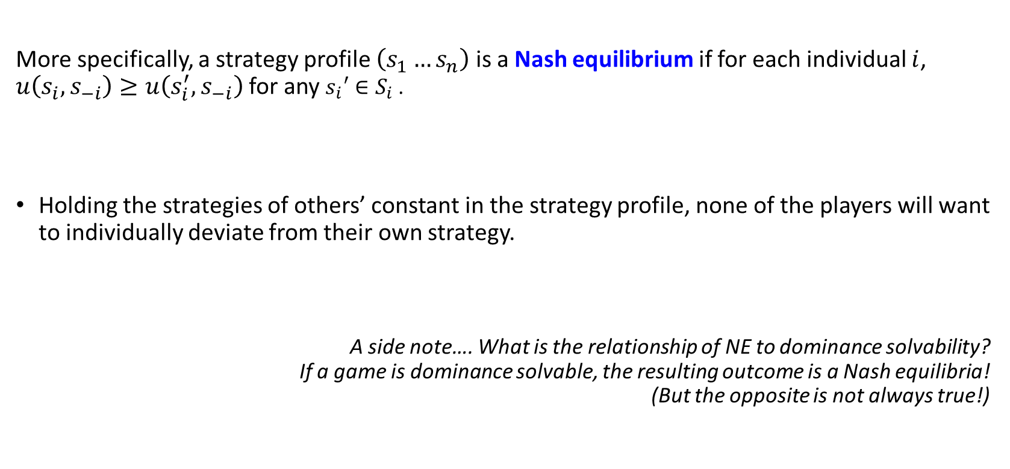
Nash Equilibria
More specifically, a strategy profile $\left(s_{1}…s_{n}\right)$ is a Nash equilibrium if for each individual $i$, $u\left(s_{i},s_{−i}\right)≥u\left(s_{i}^{′},s_{−i}\right)$for any $s_{i}′∈S_{i}$.
Holding the strategies of others’ constant in the strategy profile, none of the players will want to individually deviate from their own strategy.
A side note…. What is the relationship of NE to dominance solvability? If a game is dominance solvable, the resulting outcome is a Nash equilibria! (But the opposite is not always true!)
Notes:
So NE covers dominance solvable equilibria and more!

Slide 30
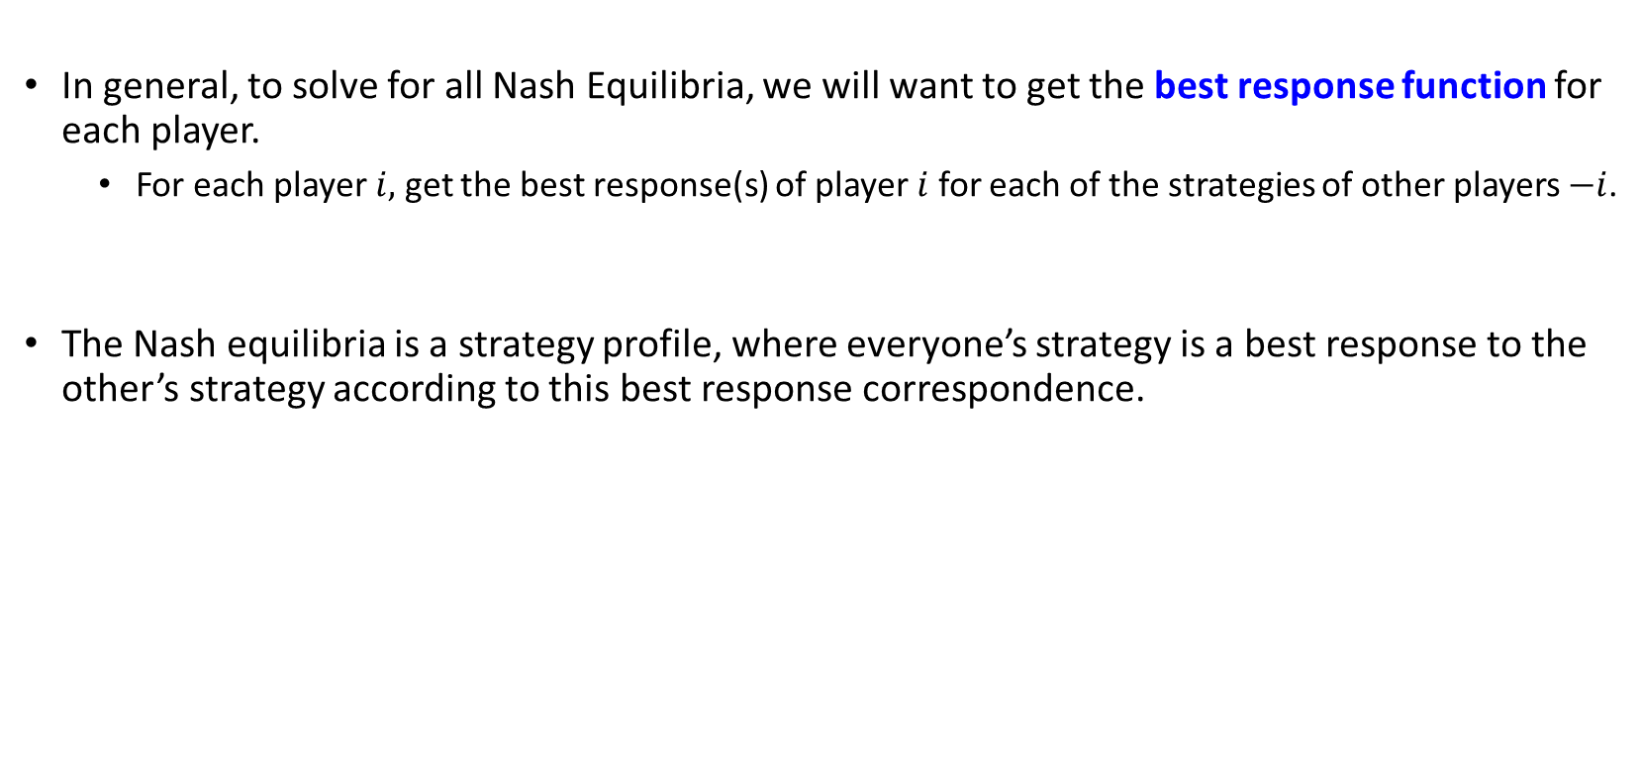
Solving for Nash Equilibria
In general, to solve for all Nash Equilibria, we will want to get the best response function for each player.
For each player $i,$ get the best response(s) of player $i$ for each of the strategies of other players $−i$.
The Nash equilibria is a strategy profile, where everyone’s strategy is a best response to the other’s strategy according to this best response correspondence.

Slide 31
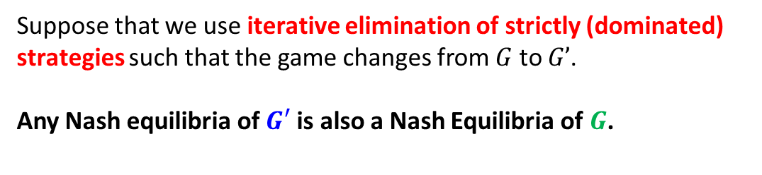
Solving for Nash Equilibria
Sometimes, you can simplify the problem by eliminating dominated strategies: this is because such bad strategies will never be part of a Nash Equilibria.
Suppose that we use iterative elimination of strictly (dominated) strategies such that the game changes from $G$ to $G’$.
Any Nash equilibria of $G′$ is also a Nash Equilibria of $G$.
Consequences:
Suppose we have a game with many strategies, you can try to use iterative elimination to simplify first, and then solve for NE.
An outcome of a dominance solvable game is a NE.

Slide 32
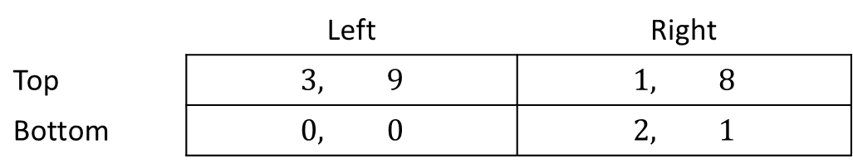
Example 1:
Player 2
Best Response Function of Player 1
If Player 2 plays Left, the best response of Player 1 is to play Top
If Player 2 plays Right, the best response of Player 1 is to play Bottom
Best Response Function of Player 2
If Player 1 plays Top, the best response of Player 2 is to play Left
If Player 1 plays Bottom, the best response of Player 2 is to play Right
 | Left | Right
Top | $$3, 9$$ | $$1, 8$$
Bottom | $$0, 0$$ | $$2, 1$$
Player 1

Slide 33
Example 1:
Player 2
 | Left | Right
Top | $$3, 9$$ | $$1, 8$$
Bottom | $$0, 0$$ | $$2, 1$$
Player 1
There are 2 strategy profiles where strategies are best responses to each other: (T,L) and (B,R) : these are Nash Equilibria of the game.
If Player 2 chooses L, Player 1 will want to choose T. Likewise, if Player 1 chooses T, Player 2 will want to choose L.
If Player 2 chooses R, Player 1 will want to choose B. Likewise, if Player 1 chooses B, Player 2 will want to choose R.
(T,R) and (B,L) are not Nash Equilibria, why?
Consider (T,R), if Player 2 chooses R, Player 1 will want to deviate to B.
Consider (B,L), if Player 2 chooses L, Player 1 will want to deviate to T.

Slide 34
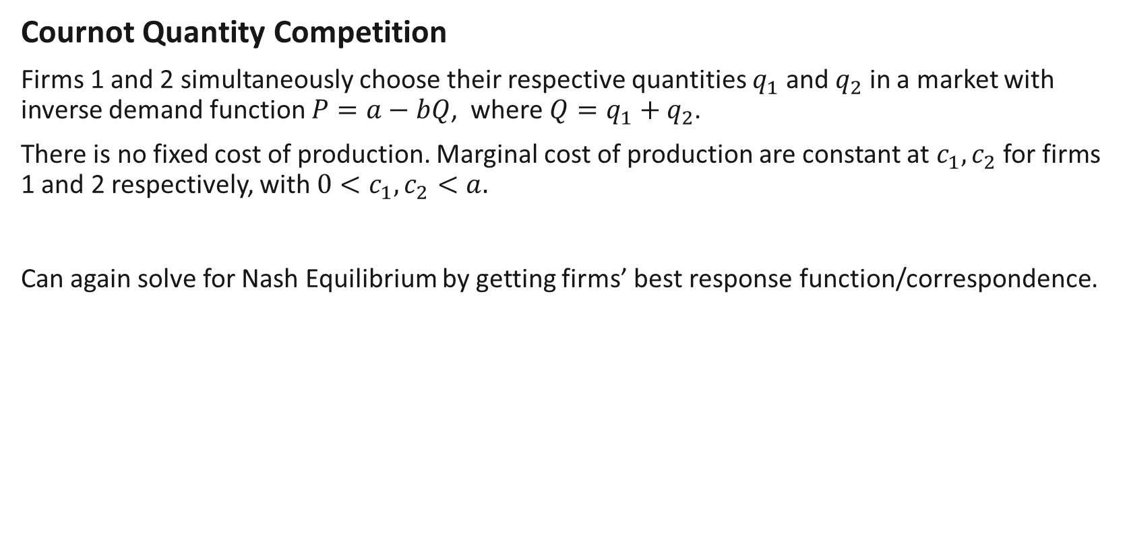
Example 2:
Cournot Quantity Competition
Firms 1 and 2 simultaneously choose their respective quantities $q_{1}$ and $q_{2}$ in a market with inverse demand function $P=a−bQ$, where $Q=q_{1}+q_{2}$.
There is no fixed cost of production. Marginal cost of production are constant at $c_{1},c_{2}$ for firms 1 and 2 respectively, with $0<c_{1},c_{2}<a.$
Can again solve for Nash Equilibrium by getting firms’ best response function/correspondence.

Slide 35
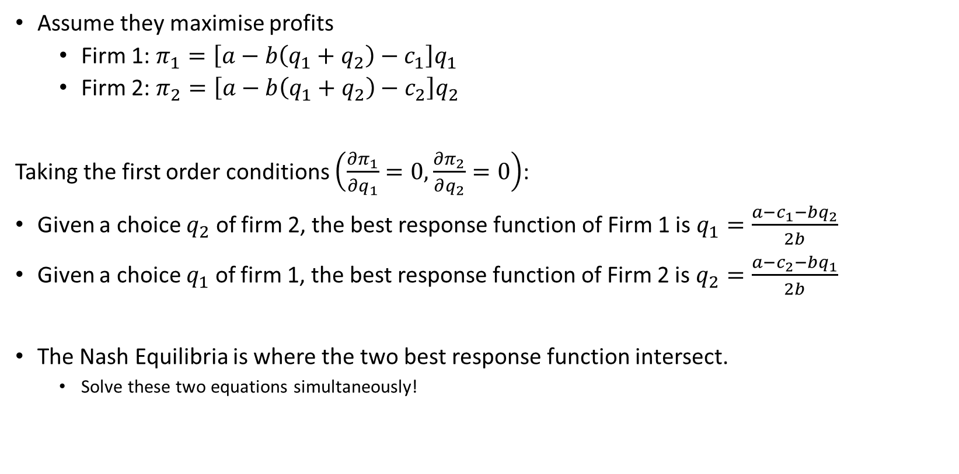
Example 2:
Assume they maximise profits
Firm 1: $π_{1}=\left[a−b\left(q_{1}+q_{2}\right)−c_{1}\right]q_{1}$
Firm 2: $π_{2}=\left[a−b\left(q_{1}+q_{2}\right)−c_{2}\right]q_{2}$
Taking the first order conditions $\left(\frac{∂π_{1}}{∂q_{1}}=0,\frac{∂π_{2}}{∂q_{2}}=0\right)$:
Given a choice $q_{2}$ of firm 2, the best response function of Firm 1 is $q_{1}=\frac{a−c_{1}−bq_{2}}{2b}$
Given a choice $q_{1}$ of firm 1, the best response function of Firm 2 is $q_{2}=\frac{a−c_{2}−bq_{1}}{2b}$
The Nash Equilibria is where the two best response function intersect.
Solve these two equations simultaneously!
Notes:
Sometimes, we may call it a best response correspondence because there might not be a unique best response to the other’s strategy.
When there are multiple best responses, mathematically it is called a correspondence.

Slide 36
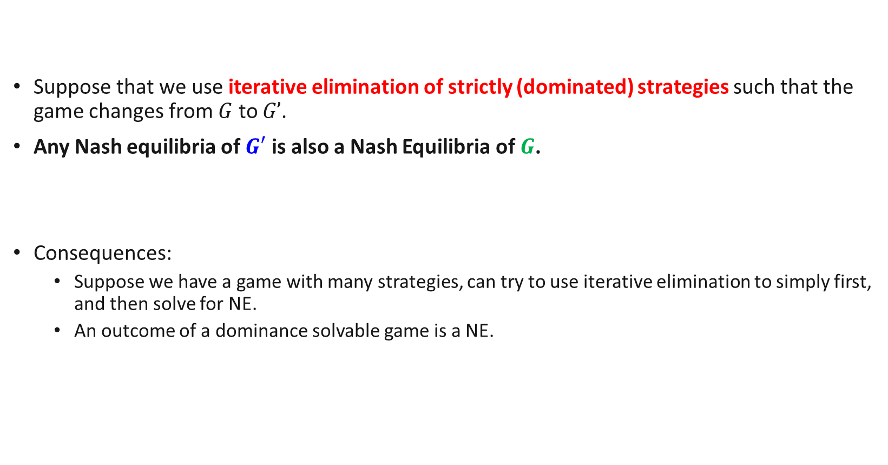
Nash Equilibria and Dominated Strategies.
Suppose that we use iterative elimination of strictly (dominated) strategies such that the game changes from $G$ to $G’$.
Any Nash equilibria of $G′$ is also a Nash Equilibria of $G$.
Consequences:
Suppose we have a game with many strategies, can try to use iterative elimination to simply first, and then solve for NE.
An outcome of a dominance solvable game is a NE.

Slide 37
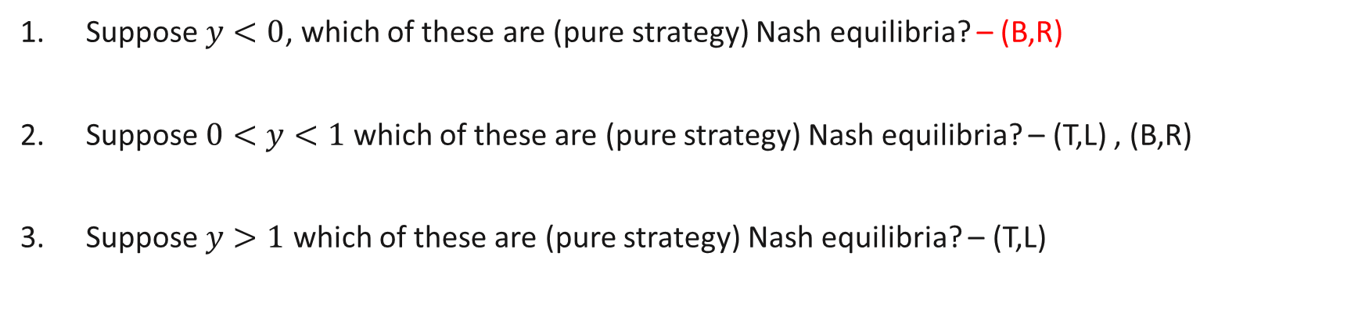
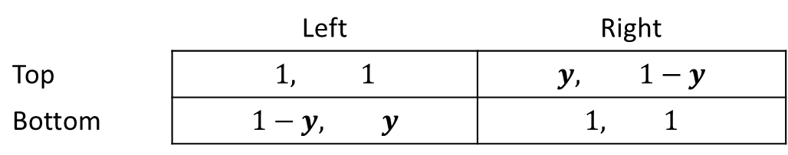
Review Questions 3
Player B
 | Left | Right
Top | $$1, 1$$ | $$y, 1−y$$
Bottom | $$1−y, y$$ | $$1, 1$$
Scan here
to participate!
Player A
Suppose $y<0$, which of these are (pure strategy) Nash equilibria? – (B,R)
Suppose $0<y<1$ which of these are (pure strategy) Nash equilibria? – (T,L) , (B,R)
Suppose $y>1$ which of these are (pure strategy) Nash equilibria? – (T,L)

Slide 38
Pure Strategies vs Mixed Strategies

Slide 39

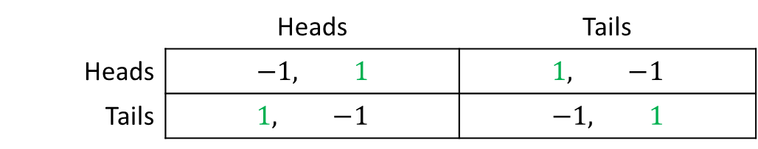
Example 3:
Matching Pennies Game
Let us try to solve for the Nash Equilibria for this game:
No Nash Equilibrium ??!!
Player 2
 | Heads | Tails
Heads | $$−1, 1$$ | $$1, −1$$
Tails | $$1, −1$$ | $$−1, 1$$
Player 1
Notes:
In this game, the payoffs represent how Player 2 wants to match with Player 1, but Player 1 doesn’t.

Slide 40
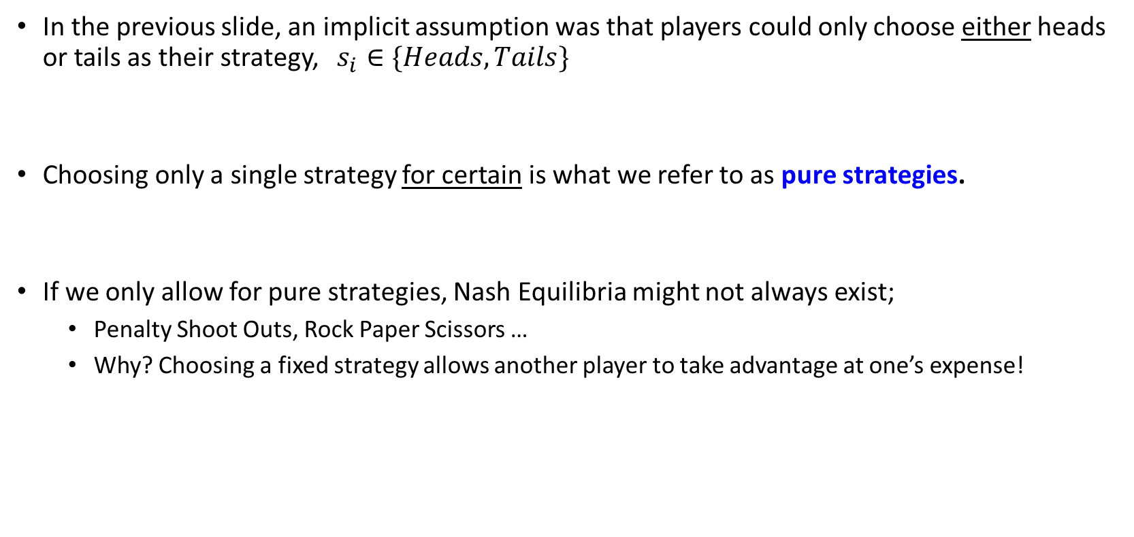
Pure Strategies
In the previous slide, an implicit assumption was that players could only choose either heads or tails as their strategy, $s_{i}∈\{Heads, Tails\}$
Choosing only a single strategy for certain is what we refer to as pure strategies.
If we only allow for pure strategies, Nash Equilibria might not always exist;
Penalty Shoot Outs, Rock Paper Scissors …
Why? Choosing a fixed strategy allows another player to take advantage at one’s expense!

Slide 41
Mixed Strategies
In real life, strategies are more complex and we can in fact randomize between strategies.
E.g. in rock, paper, scissors, we implicitly choose one of them at random each time we play.
This randomization between pure strategies is called a mixed strategy.
Intuitively, a mixed strategy is a probability distribution which tells us with what probability each pure strategy is played.
If we allow for such mixed strategies, then Nash Equilibria will always exist! Nash’s Theorem: Every finite game where strategy sets include mixed strategies will have at least one Nash Equilibrium.

Slide 42
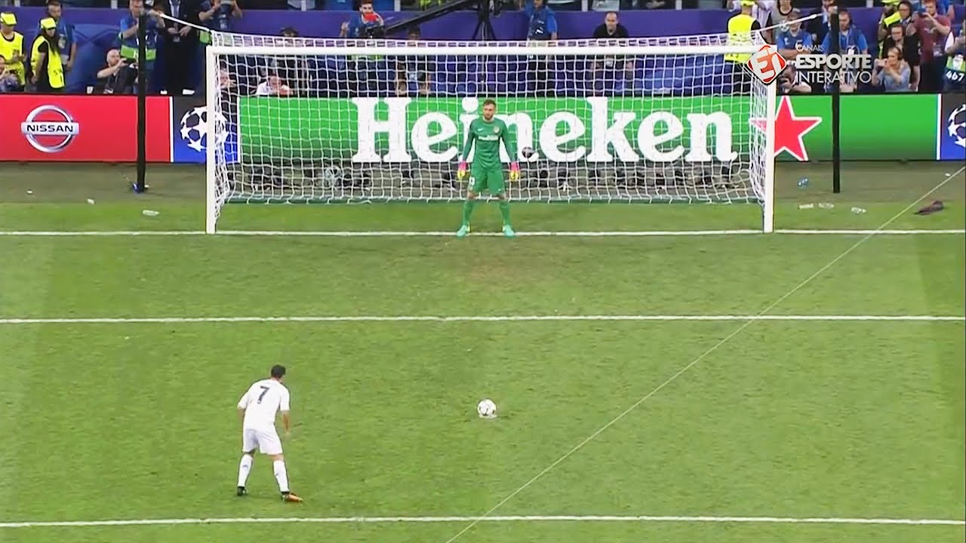
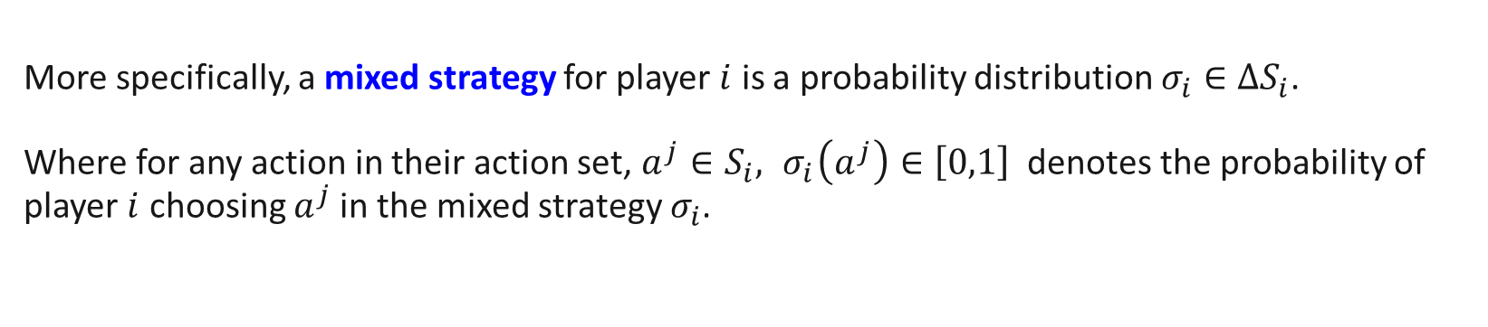



Mixed Strategies
More specifically, a mixed strategy for player $i$ is a probability distribution $σ_{i}∈ΔS_{i}$. Where for any action in their action set, $a^{j}∈S_{i}, { σ}_{i}\left(a^{j}\right)∈\left[0,1\right]$ denotes the probability of player $i$ choosing $a^{j}$in the mixed strategy $σ_{i}$.
Simply, a mixed strategy must assign some
probability between 0 and 1 to each action in their action set. The sum of all probabilities must sum to 1.
$$\frac{1}{4}$$
$$\frac{1}{4}$$
$$\frac{1}{2}$$
Next week: solving for mixed strategy Nash equilibria!
Notes:
$ΔS_{i}$ is the notation for the set of probability distributions over the set $S_{i}.$
An element $σ_{i}$ in the set $ΔS_{i}$ is a function from the set of strategies $S_{i}$ to $[0,1]$ with the restriction that $\sum_{s_{i}∈S_{i}}{σ_{i}\left(s_{i}\right)=1}$

Slide 43
Key Learning Outcomes
Understand where game theory is applicable.
The structure of a general (strategic) game.
Analysing outcomes of static games
Dominated, Dominant Strategies and Dominance Solvability.
Nash Equilibria.
Relationship between the above two.
What is the rationale behind such solution concepts and what are the assumptions made about players?

Slide 44
Readings
Varian Chapter 29
Varian Chapter 30
Osborne, An Introduction to Game Theory (optional): A game theory reference textbook
Osborne and Rubinstein, A Course in Game Theory (optional): A game theory reference textbook

